Slide 1
For Live Session
Unit 7
Carlos Estevez

Slide 2
For Live Session: Part 1 (3-5 hours)
In the last unit you used a KNN classifier to classify the passengers who survived and died. Now we will use a Naïve Bayes (NB) classifier and compare the two!
1.Using all 891 observations, train a NB model with Age and Pclass as predictors and use this model to predict the survival of a 30 year old passenger in the 1, 2 and 3 classes. Use the “type = raw” option to look at the predicted percentage of each outcome. (One slide.)
2.Split the 891 observations into a training and test set 70% - 30% using this seed and code:
titanicClean = titanic %>% filter(!is.na(Age) & !is.na(Pclass))
set.seed(4)
trainIndices = sample(seq(1:length(titanicClean$Age)),round(.7*length(titanicClean$Age)))
trainTitanic = titanicClean[trainIndices,]
testTitanic = titanicClean[-trainIndices,]
(One slide that shows the head of trainTitanic and testTitanic)
3.Train a NB model based on the training set using just the Age and Pclass variables. Use the model to predict the survival of those in the test set and use those results to evaluate the model based on accuracy, sensitivity and specificity. Finally, Compare the results to what you found with the KNN classifier. (At least one slide.)
4.Now repeat the above with a new seed and compare the accuracy, sensitivity and specificity. Do this 3 or 4 times to observe the variance in the statistics. (At least one slide.)
5.Write a loop to repeat the above for 100 different values of the seed. Find the average of the accuracy, sensitivity and specificity to get a stable (smaller variance) statistic to evaluate the model. (At least one slide.)

Slide 3
For Live Session: Part 1 (3-5 hours)
6.Now add Sex to the model so that it has Age, Pclass and Sex in the NB model. Use the trainTitanic(set.seed(4)) dataframe to train the model and create a confusion matrix using the testTitanic dataframe. In addition, find the Accuracy, Sensitivity and Specificity. (1 slide)
7.Again write a loop to get a stable estimate of the accuracy, sensitivity and specificity of this model (using 100 unique seeds). (1 slide)
8.BONUS: Using the Male and Female KNN from the bonus of Unit 6, combine the two confusion matrices from the Male and Female KNN models to make one confusion matrix and find the accuracy, sensitivity and specificity based on that model. Compare this with the performance of your NB model. Do you prefer one over the other?

Slide 4
For Live Session: Part 2 (1 – 3 hours)
a. For the full (multinomial) IRIS data (the iris dataset in R), do a 70-30 train/test cross validation and use sepal length and width as predictors. Generate 100 different train/test splits and calculate the average accuracy, sensitivity and specificity. Compare the average accuracy to that to the KNN model you used in Unit 6.

Slide 5
For Live Session: BONUS
Use the NYT News/Other Classifier code to analyze stories about Trump last month (search term “Trump”). We would like to build a classifier that will classify between news stories and other and we would like to compare two models: one that uses the headline and one that uses the snippet. Compare these two models based on sensitivity and specificity and provide at least one plot to help you visualize the results.

Slide 6
Answers!

Slide 7
Part 1: Activity 1
In the last unit you used a KNN classifier to classify the passengers who survived and died. Now we will use a Naïve Bayes (NB) classifier and compare the two!
1.Using all 891 observations, train a NB model with Age and Pclass as predictors and use this model to predict the survival of a 30 year old passenger in the 1, 2 and 3 classes. Use the “type = raw” option to look at the predicted percentage of each outcome. (One slide.)

Slide 8
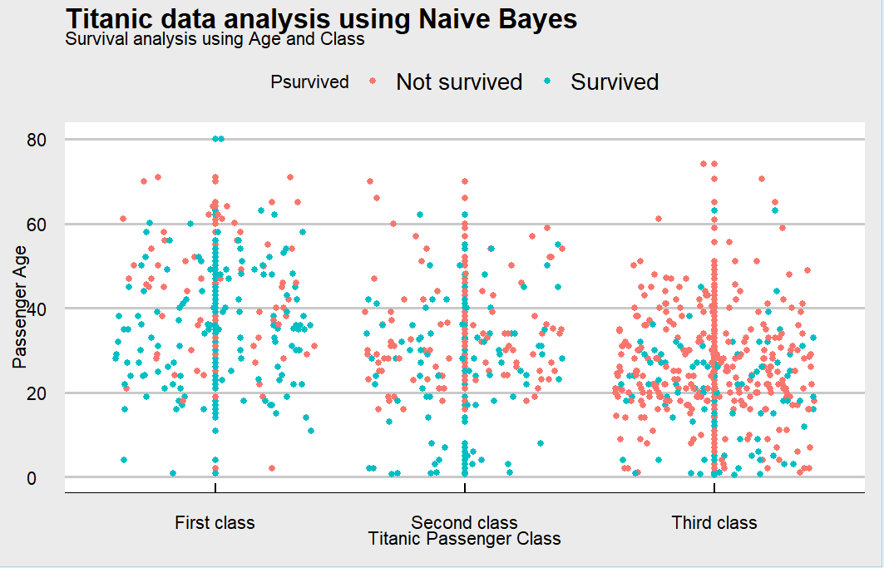
Part 1: Activity 1
Plotting the data before looking into the analysis

Slide 9
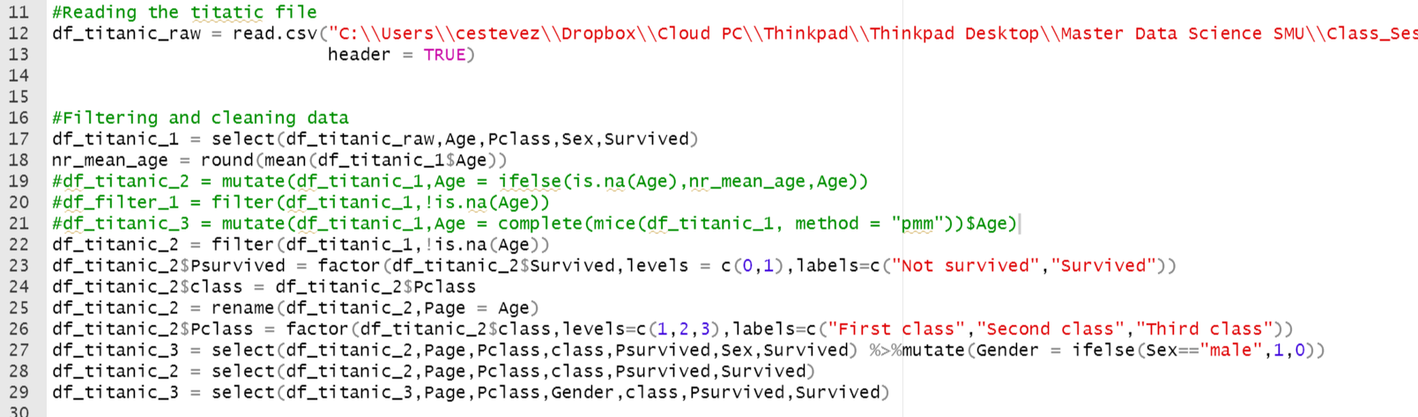
Part 1: Activity 1
Filtering and Cleaning data
We read the data from the file
We filter the unwanted NA value. We could use different approaches for data imputation such as:
Filtering NAN Values
Replacing these values by the mean
Use the package MICE
For this exercise we filtered the NAN values however we also tested using the above approaches and the results were better rather than filtering the NAN values

Slide 10
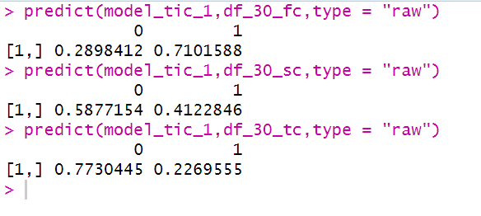
Part 1: Activity 1
Act 1: Predictions of survival
Passenger: 30 years old first class
Passenger: 30 years old second class
Passenger: 30 years old third class
Conclusion:
As you can see from the image the results are aligned to the research we conducted in the previous lesson. The first class passenger had more change of survival because of their closeness to the lifeboat and the priority and facilities given by the crew members to them
Survived: 1
Not Survived: 0

Slide 11
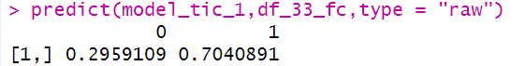
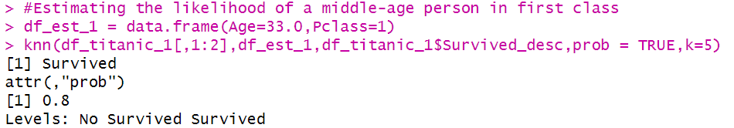
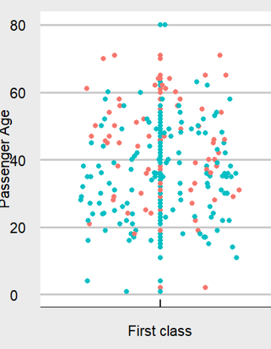
Part 1: Activity 1
Act 1: Predictions of survival
Passenger: 33 years old first class
Conclusion:
We did a comparison between KNN(5)(Previous lesson) and Naïve bayes. As the data suggest KNN says the same passenger has over 7% change of survival than NB
I would say KNN answer is better in this regard
Survived: 1
Not Survived: 0
Using Naïve Bayes
Using KNN

Slide 12
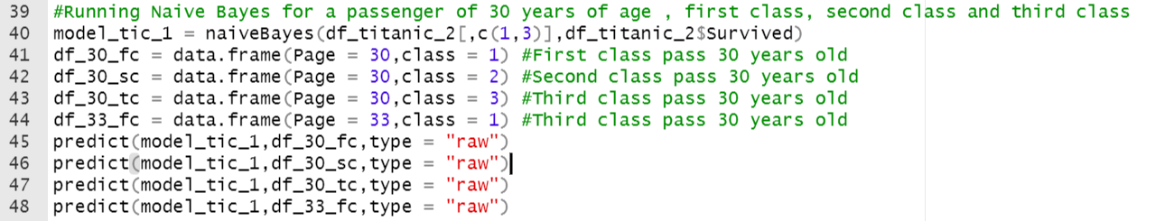
Part 1: Activity 1
Act 1: Predictions of survival: Source Code
Model initialization
Data Frame for predictions
Running the model

Slide 13
Part 1: Activity 2,3,4,5
2.Split the 891 observations into a training and test set 70% - 30% using this seed and code:
titanicClean = titanic %>% filter(!is.na(Age) & !is.na(Pclass))
set.seed(4)
trainIndices = sample(seq(1:length(titanicClean$Age)),round(.7*length(titanicClean$Age)))
trainTitanic = titanicClean[trainIndices,]
testTitanic = titanicClean[-trainIndices,]
(One slide that shows the head of trainTitanic and testTitanic)
3.Train a NB model based on the training set using just the Age and Pclass variables. Use the model to predict the survival of those in the test set and use those results to evaluate the model based on accuracy, sensitivity and specificity. Finally, Compare the results to what you found with the KNN classifier. (At least one slide.)
4.Now repeat the above with a new seed and compare the accuracy, sensitivity and specificity. Do this 3 or 4 times to observe the variance in the statistics. (At least one slide.)
5.Write a loop to repeat the above for 100 different values of the seed. Find the average of the accuracy, sensitivity and specificity to get a stable (smaller variance) statistic to evaluate the model. (At least one slide.)

Slide 14
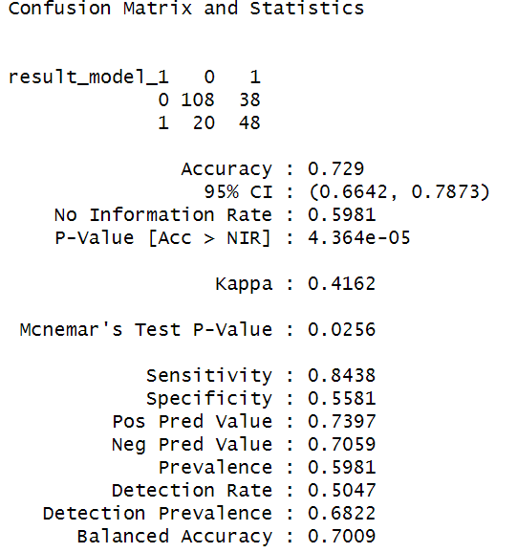
Part 1: Activity 2
Training the model seed = 4
As we can see here the accuracy of the model when we use a seed of 4 is 73%
The data also suggests that the sensitivity is very good
The specificity however is not that good

Slide 15
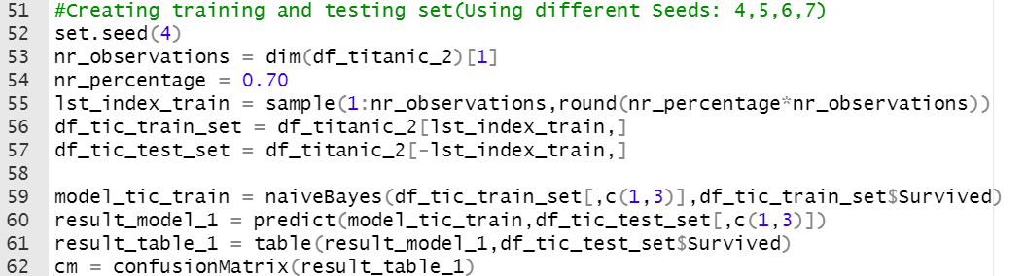
Part 1: Activity 2
Source code
Setting seed to 4
Creating sample indexes
Creating training and testing data
Training the model using training data
Running the model using testing data

Slide 16
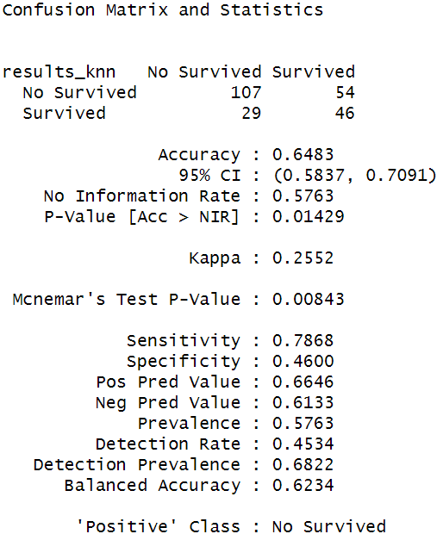
Part 1: Activity 3
Training the model seed = 4 and comparison with KNN = 5
As you can see from the two images the model accuracy for Naïve Bayes is much higher than KNN
Image 1: NB model
Image 2: Knn results(k=5)

Slide 17
Part 1: Activity 4
For this activity we used the same piece of code we have used previously. We just adjusted the value of seed several times

Slide 18
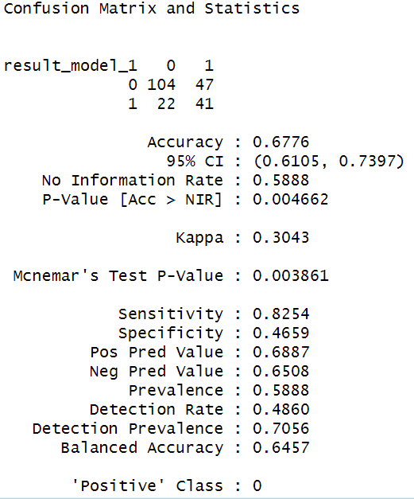
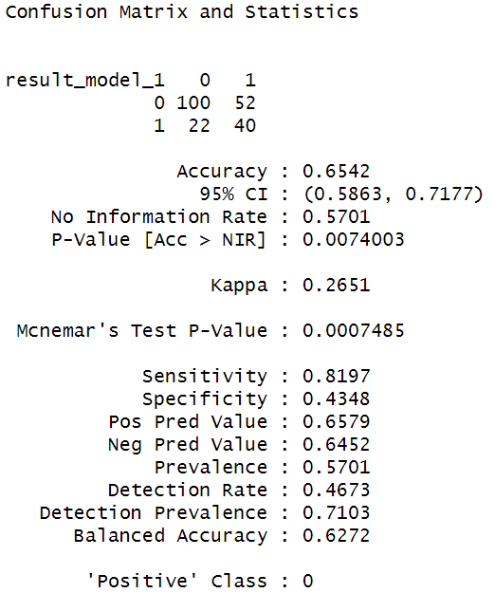
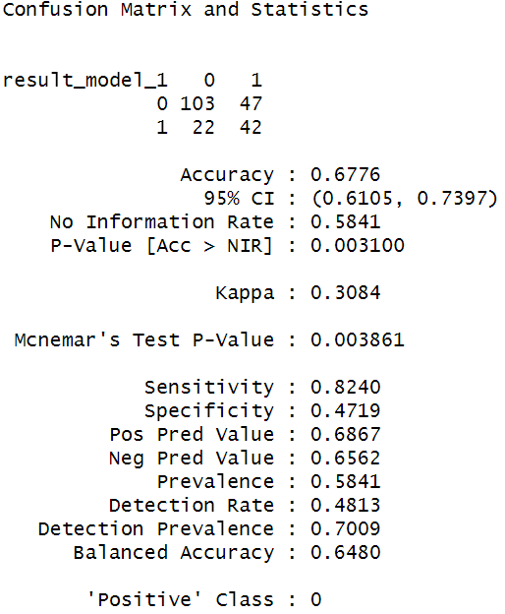
Part 1: Activity 4
Setting different values for seed
Seed = 4, 72%
Seed = 5, 68%
Seed = 6, 65%
Seed = 7, 68%
Image 1: Seed = 4
Image 2: Seed = 5
Image 3: Seed = 6
Image 4: Seed = 7

Slide 19
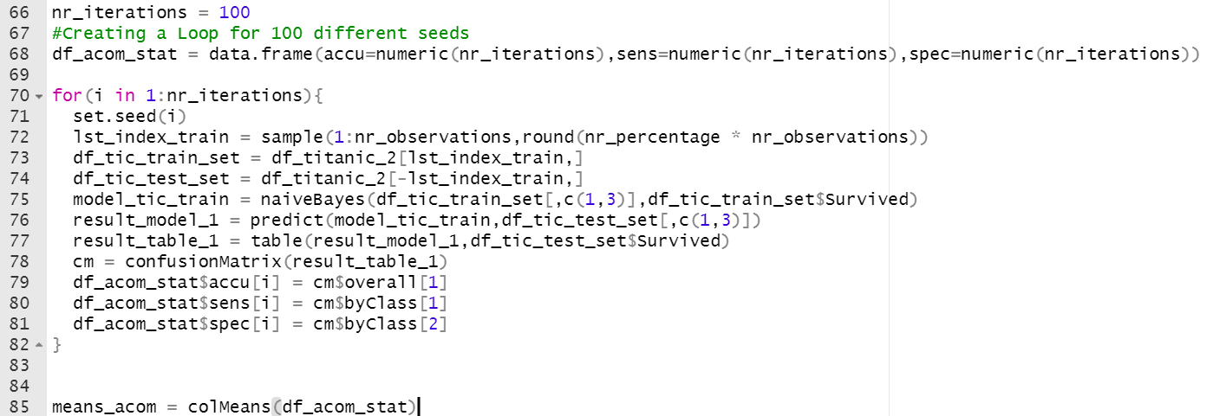
Part 1: Activity 5
Using 100 different values of Seed
Accuracy: 0.69
Sensitivity: 0.85
Specificity: 0.46
We establish the number of iterations we want to realize our evaluation
We create a data frame to store the different results according to the number of iteration
We set the seed in the loop
We train the model
We run the model
We accumulate the results
We calculate the means of the three keyfigure

Slide 20
Part 1: Activity 6,7,8
6.Now add Sex to the model so that it has Age, Pclass and Sex in the NB model. Use the trainTitanic(set.seed(4)) dataframe to train the model and create a confusion matrix using the testTitanic dataframe. In addition, find the Accuracy, Sensitivity and Specificity. (1 slide)
7.Again write a loop to get a stable estimate of the accuracy, sensitivity and specificity of this model (using 100 unique seeds). (1 slide)
8.BONUS: Using the Male and Female KNN from the bonus of Unit 6, combine the two confusion matrices from the Male and Female KNN models to make one confusion matrix and find the accuracy, sensitivity and specificity based on that model. Compare this with the performance of your NB model. Do you prefer one over the other?

Slide 21
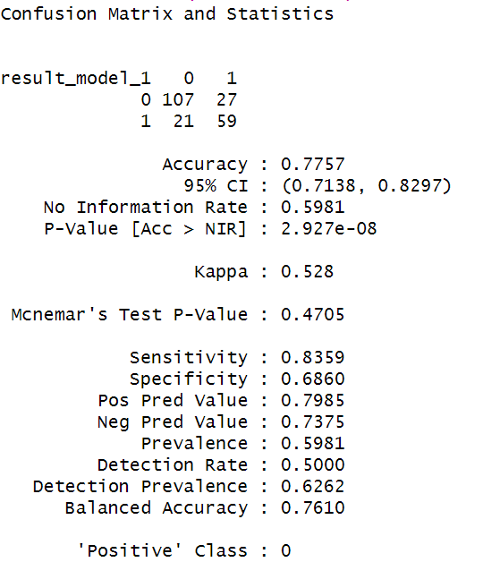
Part 1: Activity 6
Confusion matrix adding the Gender
As you can see the model accuracy is higher when we include gender
In the previous lesson we corroborate this information with a research. According to the historical records they prioritized saving children and women before men,

Slide 22
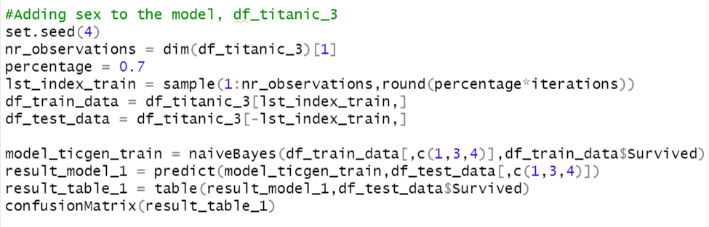
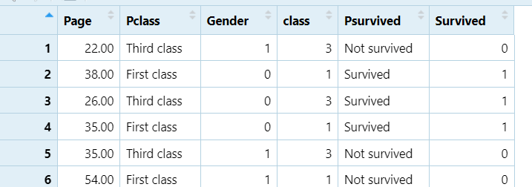
Part 1: Activity 6
Confusion matrix adding the Gender
We pretty much applied the same concepts to create and run the model. The only minor different was the inclusion of a third predictor(Sex or Gender)

Slide 23
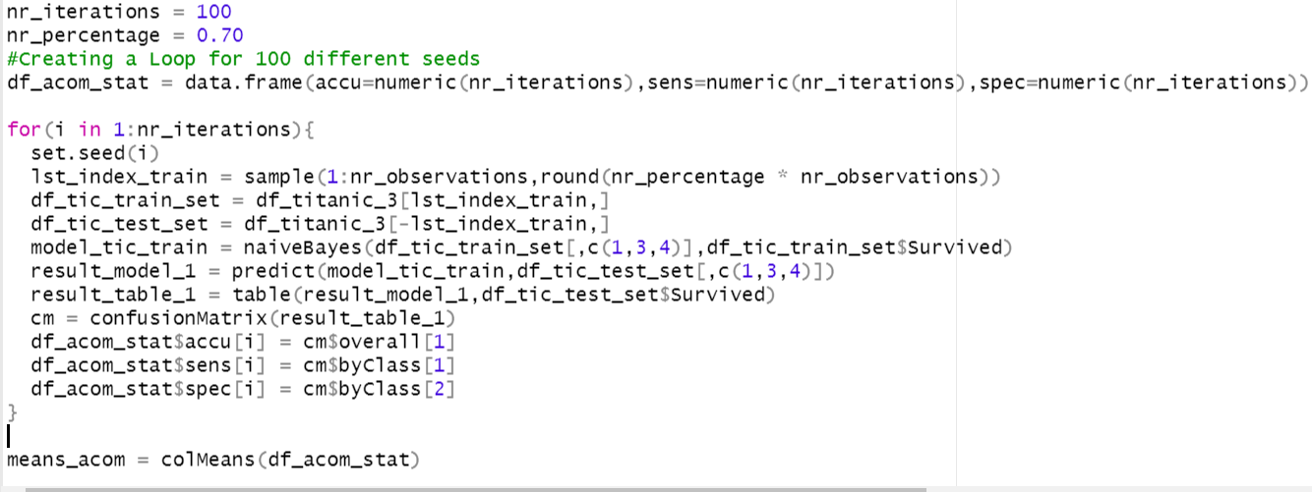
Part 1: Activity 7
Creating a iteration of 100 seeds
Accuracy: 78%
Sensitivity: 84%
Specificity: 0.68%
These results suggest that the model is more accurate when we take into consideration the gender
We establish the number of iterations we want to realize our evaluation
We create a data frame to store the different results according to the number of iteration
We set the seed in the loop
We train the model and run the model
We calculate the means of the three keyfigure

Slide 24
Part 1: Activity 8
8.BONUS: Using the Male and Female KNN from the bonus of Unit 6, combine the two confusion matrices from the Male and Female KNN models to make one confusion matrix and find the accuracy, sensitivity and specificity based on that model. Compare this with the performance of your NB model. Do you prefer one over the other?
KNN Analysis
Iterations k= 1:100 , Iterations=1:100
Accuracy: 77%
Sensitivity: 98%
Specificity: 67%
NB Analysis 100 iterations
Accuracy: 78%
Sensitivity: 84%
Specificity: 68%
Conclusion: Both models are pretty close in terms of accuracy. However, I will use KNN for this problem

Slide 25
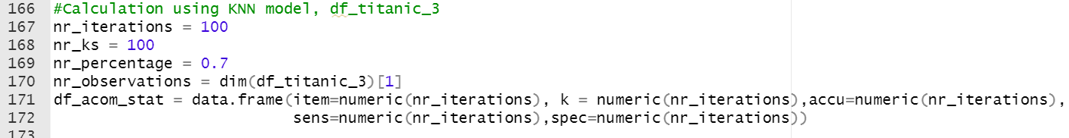
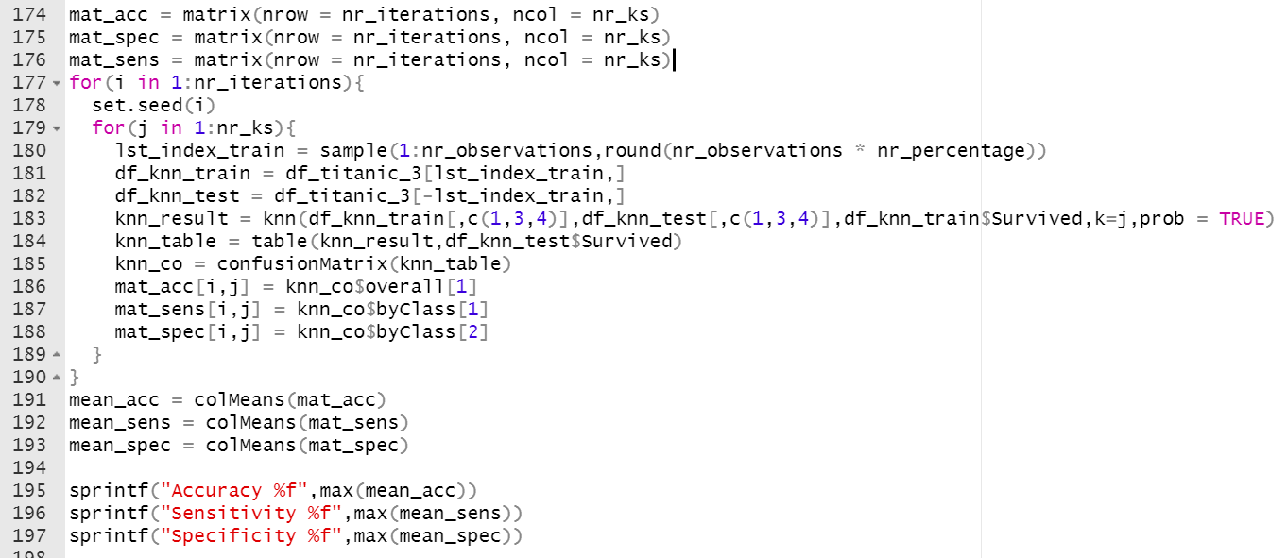
Part 1: Activity 8
KNN Source Code
Set the number of iterations
Set the number of k
Create three matrixes for accumulating the model results
Accumulating the results
Calculating the mean of the stat data

Slide 26
For Live Session: Part 2
a. For the full (multinomial) IRIS data (the iris dataset in R), do a 70-30 train/test cross validation and use sepal length and width as predictors. B.Generate 100 different train/test splits and calculate the average accuracy, sensitivity and specificity. Compare the average accuracy to that to the KNN model you used in Unit 6.

Slide 27
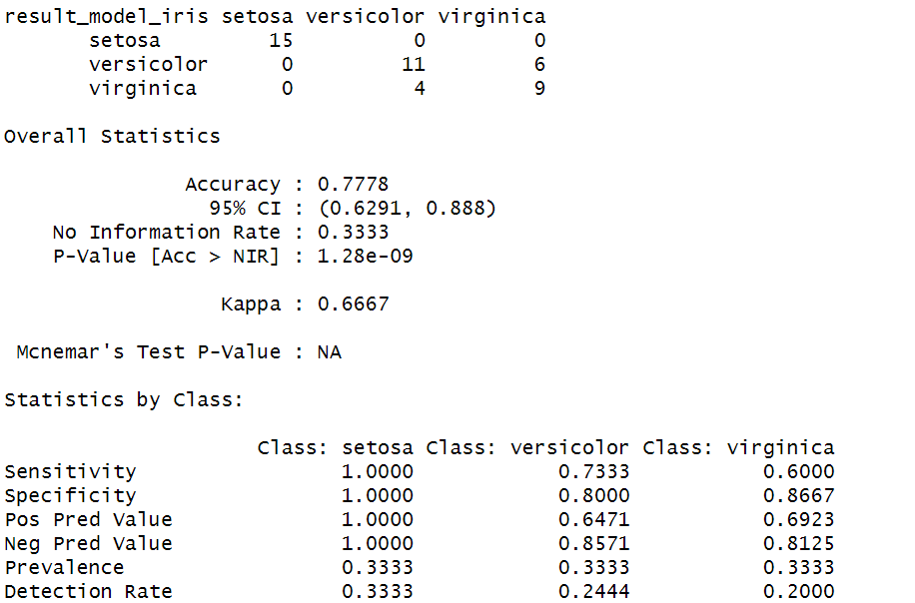
Part 2: Activity a
Results of the IRIS dataset setting seed to 4
As we can see here the results are very promising. The accuracy of the model is quite good

Slide 28
Part 2: Activity a
Results of the IRIS dataset with 100 iterations and different values of seed
>100 different seeds
Accuracy NB: 0.78
Sensitivity NB: 0.98
Specificity NB: 0.73
>90 different of K
Accuracy KNN: 0.78
Sensitivity KNN: 0.66
Specificity NB: 0.99
Conclusion: It seems that the results of NB are better. Because I think KNN is overfitting specially when it comes to specificity

Slide 29
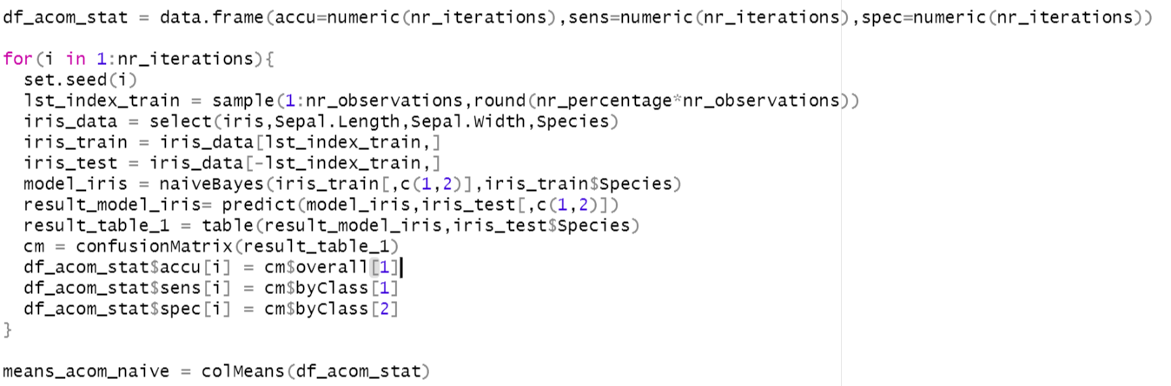
Part 2: Activity a
Source code
We create a data frame for storing the accumulated results
We create the training and testing data
We run the model
We calculate the mean of the results

Slide 30
For Live Session: BONUS
Use the NYT News/Other Classifier code to analyze stories about Trump last month (search term “Trump”). We would like to build a classifier that will classify between news stories and other and we would like to compare two models: one that uses the headline and one that uses the snippet. Compare these two models based on sensitivity and specificity and provide at least one plot to help you visualize the results.

Slide 31
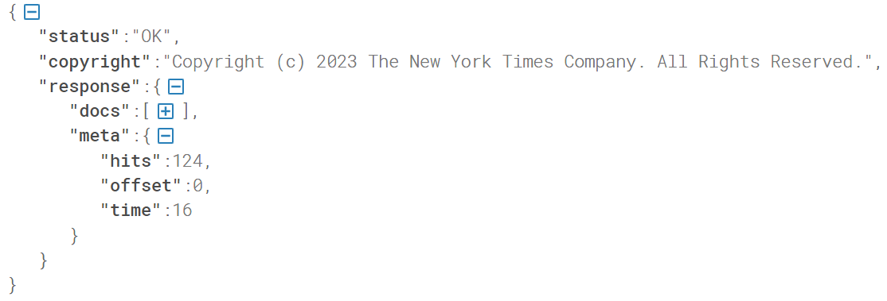
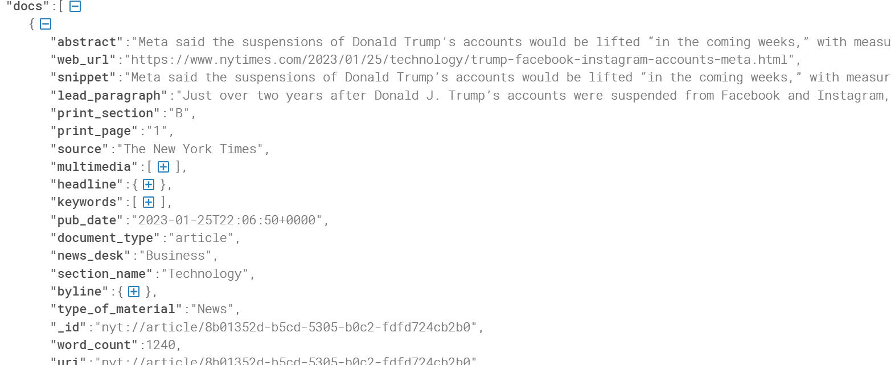
Bonus
Hierarchy 1
Understanding the JSON Structure
Use the website:
https://jsonformatter.curiousconcept.com/#
Response: Response of Webserver
Docs: Array of documents
Meta: Information about the response. We will use the number of hits to determine the number of returned pages
Structure of a document
Snipped
Headlines

Slide 32
Bonus
Hierarchy 1
Understanding the JSON Structure
Use the website:
https://jsonformatter.curiousconcept.com/#
Structure of a document
Snipped
Headlines

Slide 33
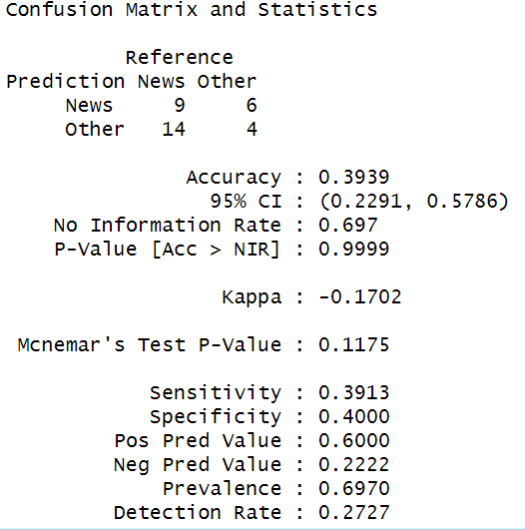
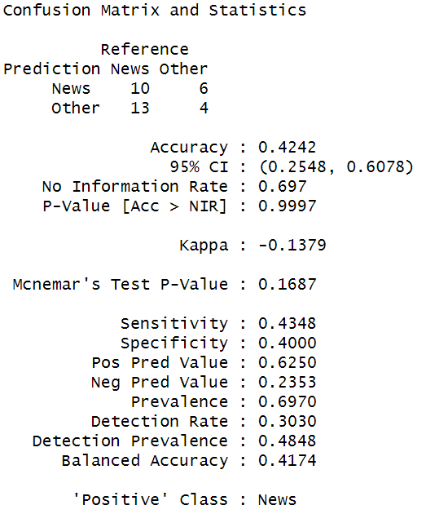
Bonus using 10 pages
Results with headlines
Source Code
We used the same source code that we saw in the example we change the following lines of code
Results with Snippet

Slide 34

Part 3 ($≤1 hour$)
Takeaways
Naïve Bayes is a powerful classifier similar in many aspects to KNN
I think NB is much faster than KNN, I did the same tests and NB finished in much less time. I think the reason behind that is that we need to find the most suitable value for K and we don’t have to do that using NB
Questions
I don’t know how I can determine when I should use one algorithm and the other. We calculated the model accuracy and we did a comparison between two models. So I guess that we will choose it based on the better accuracy. I still have my doubts
I was thinking about the Bonus exercise using naiveBayes e1071. How would you do it? Perhaps creating a new column by each word?

